Slide 1

CAPSTONE PROJECT INTERIM PRESENTATION
Online Shoppers Purchasing Intention Prediction
Submitted By:
Surbhi Bhatia
Siddharth Shankar
Rahul Das
Vaibhav Bhatnagar
Jalaj Tripathi
Mentored By:
Mr. Romil Gupta

Slide 2

BUSINESS BACKGROUND
According to Forbes, Ecommerce will become the largest retail channel in the world by 2021 and to cater such a major increase in the online retail and ecommerce activity retailers will need to tailor their digital strategies appropriately
Average rate of consumers who do not fulfil the process of shopping transaction is approximately 70 percent in 2010
Almost 95 percentage of internet users visit online retailers without purpose of actually making a transaction

Slide 3
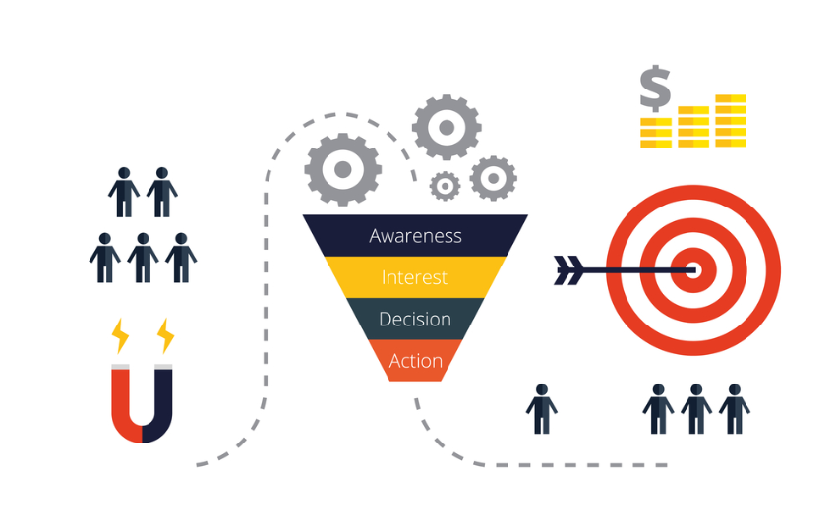

BUSINESS PROBLEM
4 Step Sales Funnel
Customer Journey Focused
Prospects
Predict the purchasing intention of the visitor using aggregated pageview data track during the visit along with some session and user information
To build the visitor behavior analysis model measuring the user’s intention to finalize the transaction
True Customers
Source: digitalmarketinginstitute.com

Slide 4



PROJECT OVERVIEW
Upcoming Deposits
$
12,330
12,205
Attributes
18
Numerical
10
Customer Sessions
84.37% Revenue Not Generated
15.63% Revenue Generated
Categorical
8
Duplicates: 125
Imbalance Class
Target Class
Revenue
Market Location
Sportswear Market
The dataset was formed so that each session would belong to a different user in a 1-year period to avoid any tendency to a specific campaign, special day, user profile, or period.
Note
3.4% GROWTH*
CAGR in 5 Years
2894 Million USD
Columbia Sales in 2019

